Slide 1
Architectural design

Slide 2
Objectives
introduce the concepts of software architecture and architectural design.
understand why the architectural design of software is important;
understand the decisions that have to be made about the system architecture during the architectural design process;
introduce to three complementary architectural styles covering the overall system organization, modular decomposition and control;
understand how reference architectures are used to communicate architectural concepts and to assess system architectures

Slide 3
Contents
Definition
Architectural design decisions
System organization
Modular decomposition styles
Control styles

Slide 4
Definition
Large systems are always decomposed into sub-systems that provide some related set of services.
Architectural design process is:
The initial design process of identifying these sub-systems and establishing a framework for sub-system control and communications
Concerned with establishing a basic structural framework that identifies the major components of a system and the communications between these components.
The output of this design process is a description of the software architecture.

Slide 5
Definition (cont … 1)
Three advantages of explicitly designing and documenting a software architecture:
Stakeholder communication, The architecture is a high-level presentation of the system that may be used as a focus for discussion by a range of different stakeholders.
System analysis, Making the system architecture explicit at an early stage in the system development requires some analysis.
Large-scale reuse, A system architecture model is a compact, manageable description of how a system is organized and how the components interoperate. The system architecture is often the same for systems with similar requirements and so can support large-scale software reuse.

Slide 6
Definition (cont … 1)
The system architecture affects the performance, robustness, distributability and maintainability of a system.
The particular style and structure chosen for an application may therefore depend on the non-functional system requirements:
Performance, the architecture should be designed to localize critical operations within a small number of subsystems, with as little communication as possible between these sub-systems.

Slide 7
Definition (cont … 1)
Security , a layered structure for the architecture should be used, with the most critical assets protected in the innermost layers and with a high level of security validation applied to these layers.
Safety, the architecture should be designed so that safety-related operations are all located in either a single sub-system or in a small number of sub-systems.

Slide 8
Definition (cont … 1)
Availability, the architecture should be designed to include redundant components and so that it is possible to replace and update components without stopping the system.
Maintainability, the system architecture should be designed using fine-grain, self-contained components that may readily be changed. Producers of data should be separated from consumers and shared data structures should be avoided.

Slide 9
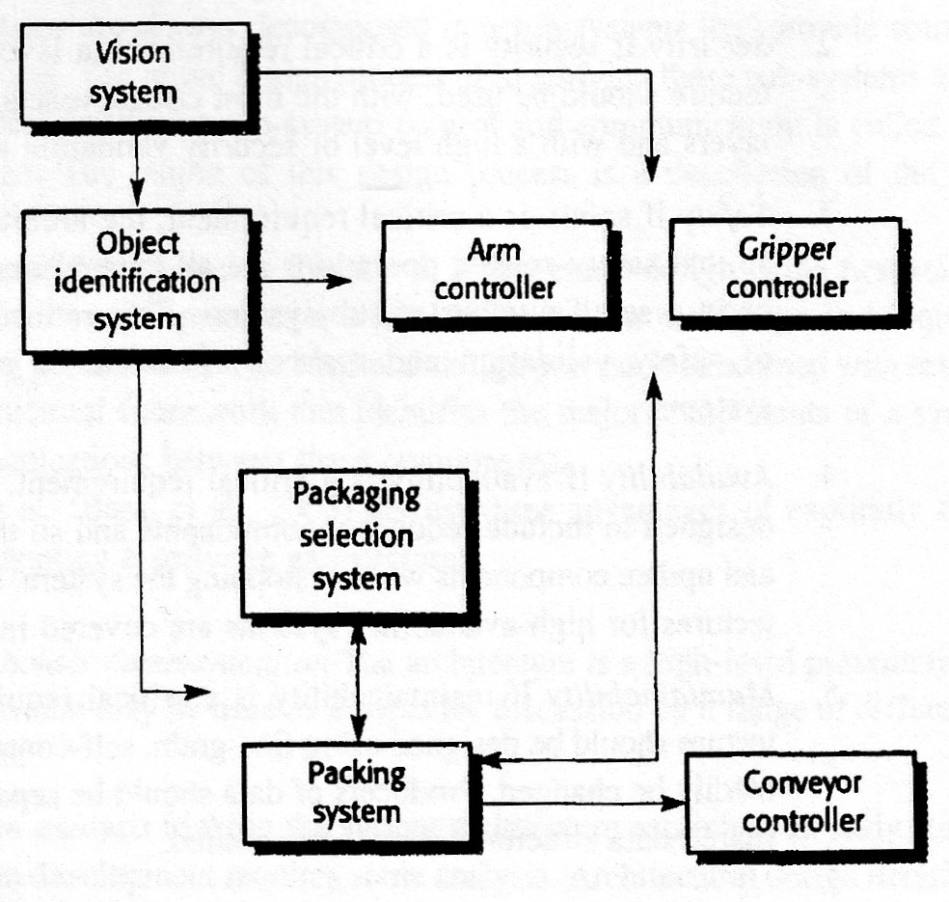
Example
An abstract model of the architecture for a packing robot system that shows the sub-systems that have to be developed.
Figure 1 Model of architecture

Slide 10
Example (cont … 1)
This robotic system can pack different kinds of object. It uses a vision sub-system to pick out objects on a conveyor, identify the type of object and select the right kind of packaging.
The system then moves objects from the delivery conveyor to be packaged.
It places packaged objects on another conveyor.

Slide 11
Architectural design decisions
Architectural design is a creative process where we try to establish a system organization that will satisfy the functional and non-functional system requirements.
Because it is a creative process, the activities within the process differ radically depending on the type of system being developed, the back-ground and experience of the system architect, and the specific requirements for the system.
It is therefore more useful to think of the architectural design process from a decision perspective rather than from an activity perspective.

Slide 12
Architectural design decisions (cont … 1)
They have to answer the following fundamental questions:
Is there a generic application architecture that can act as a template for the system that is being designed?
How will the system be distributed across a number of processors?
What architectural style or styles are appropriate for the system?

Slide 13
Architectural design decisions (cont … 2)
What will be the fundamental approach used to structure the system?
How will the structural units in the system be decomposed into modules?
What strategy will be used to control the operation of the units in the system?
How will the architectural design be evaluated?
How should the architecture of the system be documented?

Slide 14
Architectural design decisions (cont … 3)
Architectural models include:
A static structural model that shows the sub-systems or components that are to be developed as separate units.
A dynamic process model that shows how the system is organized into processes at run-time.
An interface model that defines the services offered by each sub-system through its public interface.
Relationship models that shows relationships, such as data flow, between the sub-systems.
A distribution model that shows how sub-systems may be distributed across computers.

Slide 15
System organisation
The organization of a system reflects the basic strategy that is used to structure a system. You have to make decisions on the overall organizational model of a system early in the architectural design process.
The system organization may be directly reflected in the sub-system structure. However, it is often the case that the sub-system model includes more detail than the organizational model, and there is not always a simple mapping from sub-systems to organizational structure.

Slide 16
The repository model
Sub-systems making up a system must exchange information so that they can work together effectively. There are two fundamental ways in which this can be done.
All shared data is held in a central database that can be accessed by 0 subsystems. A system model based on a shared database is sometimes called a repository model.
Each sub-system maintains its own database. Data is interchanged with other sub-systems by passing messages to them.

Slide 17
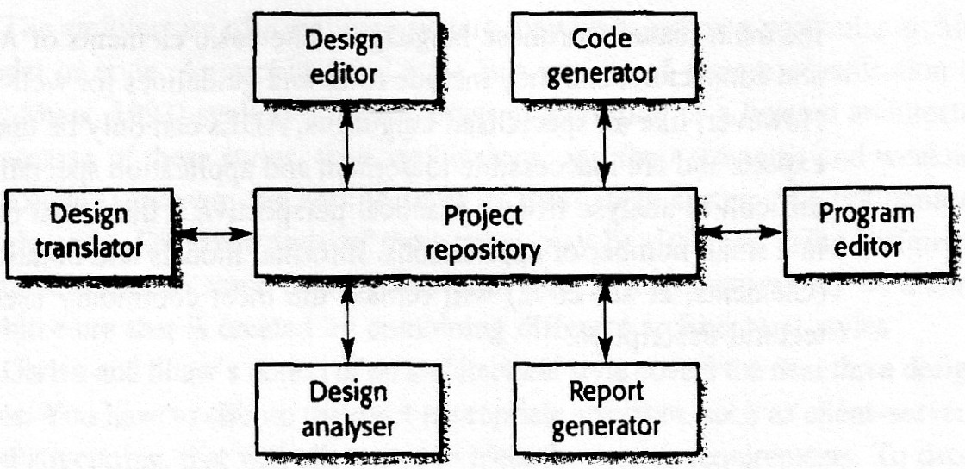
Example
Figure 2 The architecture of an integrated CASE toolset

Slide 18
Example (cont … 1)
The majority of systems that use large amounts of data are organized around a shared database or repository.
This model is therefore suited to applications where data is generated by one sub-system and used by another.
Examples of this type of system include command and control systems, management information systems, CAD (Computer-Aided Design) systems and CASE (Computer-Aided Software Engineering) toolsets.

Slide 19
The repository model (cont …1)
The advantages and disadvantages of a shared repository are as follows:
It is an efficient way to share large amounts of data. There is no need to transmit data explicitly from one sub-system to another.
However, sub-systems must agree on the repository data model. Inevitably, this is a compromise between the specific needs of each tool. Performance may be adversely affected by this compromise. It may be difficult or impossible to integrate new sub-systems if their data models do not fit the agreed schema.

Slide 20
The advantages and disadvantages (cont … 1)
Sub-systems that produce data need not be concerned with how that data is used by other sub-systems.
However, evolution may be difficult as a large volume of information is generated according to an agreed data model. Translating this to a new model will certainly be expensive; it may be difficult or even impossible.

Slide 21
The advantages and disadvantages (cont … 2)
Activities such as backup, security, access control and recovery from error are centralised. They are the responsibility of the repository manager. Tools can focus on their principal function rather than be concerned with these issues.
However, different sub-systems may have different requirements for security, recovery and backup policies. The repository model forces the same policy on all sub-systems.

Slide 22
The advantages and disadvantages (cont … 2)
The model of sharing is visible through the repository schema. It is straightforward to integrate new tools given that they are compatible with the agreed data model.
However, it may be difficult to distribute the repository over a number of machines. Although it is possible to distribute a logically centralized repository. there may be problems with data redundancy and inconsistency.

Slide 23
The client-server model
The client–server architectural model is a system model where the system is organized as a set of services and associated servers and clients that access and use the services.
The major components of this model are:
A set of servers that offer services to other sub-systems. Examples of servers are print servers that offer printing services, file servers that offer file management services and a compile server, which offers programming language compilation services.

Slide 24
The client-server model (cont … 1)
A set of clients that call on the services offered by servers. These are normally sub-systems in their own right. There may be several instances of a client program executing concurrently.
A network that allows the clients to access these services. This is not strictly necessary as both the clients and the servers could run on a single machine. In practice, however, most client–server systems are implemented as distributed systems

Slide 25
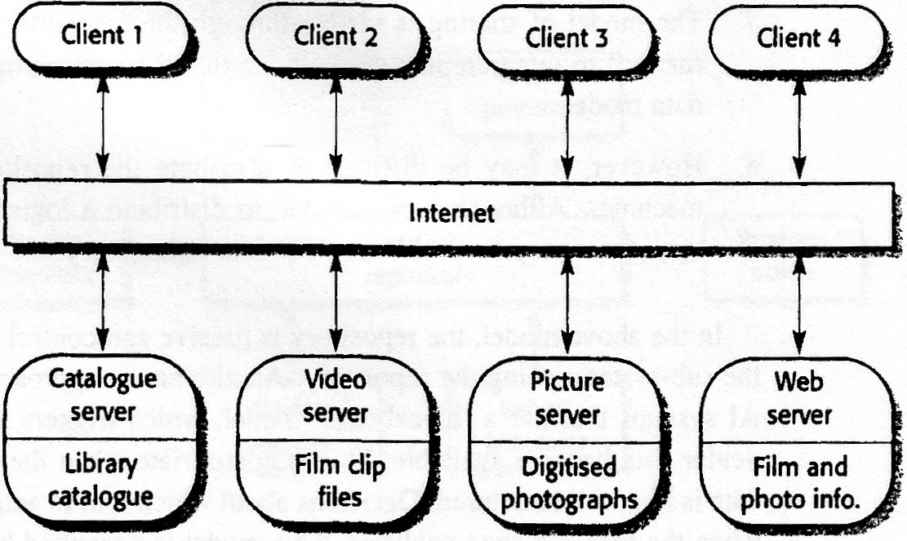
Example
Figure 3 The architecture of a film and picture library system

Slide 26
Example (cont … 1)
Figure 3 shows an example of a system that is based on the client—server model.
This is a multi-user, web-based system to provide a film and photograph system, several servers manage and display the different types of media.
Video frames need to be transmitted quickly and in synchrony but at relatively low resolution. They may be compressed in a store, so the video server may handle video compression and decompression into different formats.

Slide 27
Example (cont … 1)
The catalogue must be able to deal with a variety of queries and provide links into the web information system that includes data about the film and video clip, and an e-commerce system that supports the sale of film and video clips.
The client program is simply an integrated user interface, constructed using a web browser, to these services.
The most important advantage of the client–server model is that it is a distributed architecture. Effective use can be made of networked systems with many distributed processors.

Slide 28
The layered model
The layered model of an architecture (sometimes called an abstract machine model) organizes a system into layers, each of which provide a set of services.
Each layer can be thought of as an abstract machine whose machine language is defined by the services provided by the layer. This 'language' is used to implement the next level of abstract machine. For example, a common way to implement a language is to define an ideal 'language machine' and compile the language into code for this machine. A further translation step then converts this abstract machine code to real machine code.

Slide 29
An example of a layered model is the OSI reference model of network protocols. Another influential example was proposed by Buxton (Buxton, 1980), who suggested a three-layer model for an Ada Programming Support Environment (APSE).
Figure 4 reflects the APSE structure and shows how a configuration management system might be integrated using this abstract machine approach.

Slide 30
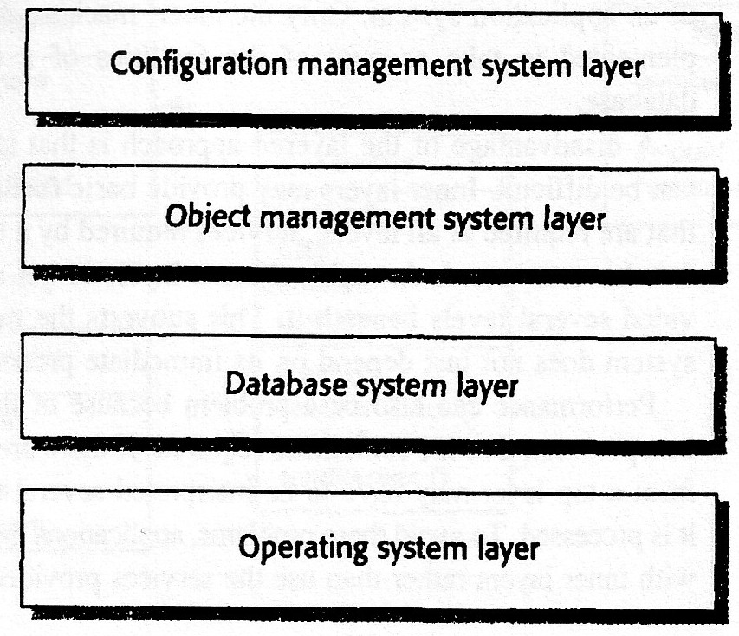
Example
Figure 4 Layered model of a version management system

Slide 31
Example (cont … 1)
A disadvantage of the layered approach is that structuring systems in this way can be difficult. Inner layers may provide basic facilities, such as file management, that are required at all levels.
Services required by a user of the top level may therefore have to 'punch through' adjacent layers to get access to services that are provided several levels beneath it.

Slide 32
Example (cont … 2)
Performance can also be a problem because of the multiple levels of command interpretation that are sometimes required.
If there are many layers, a service request from a top layer may have to be interpreted several times in different layers before it is processed.
To avoid these problems, applications may have to communicate directly with inner layers rather than use the services provided by the adjacent layer.

Slide 33
Modular decomposition styles
After an overall system organization has been chosen, we need to make a decision on the approach to be used in decomposing sub-systems into modules.
There is not a rigid distinction between system organization and modular decomposition.
However, the components in modules are usually smaller than sub-systems, which allows alternative decomposition styles to be used.

Slide 34
Modular decomposition styles (cont … 1)
Distinction between sub-systems and modules:
A sub-system is a system in its own right whose operation does not depend on the services provided by other sub-systems. Sub-systems are composed of modules and have defined interfaces, which are used for communication with other sub-systems.
A module is normally a system component that provides one or more services to other modules. It makes use of services provided by other modules. It is not normally considered to be an independent system. Modules are usually composed from a number of other simpler system components.

Slide 35
Modular decomposition styles (cont … 2)
There are two main strategies to decompose a sub-system into modules:
Object-oriented decomposition, where a system is decomposed into a set of communicating objects.
Function -oriented pipelining, where a system is decomposed into functional modules that accept input data and transform it into output data.
In the object-oriented approach, modules are objects with private state and defined operations on that state. In the pipelining model, modules are functional transformations. In both cases, modules may be implemented as sequential components or as processes.

Slide 36
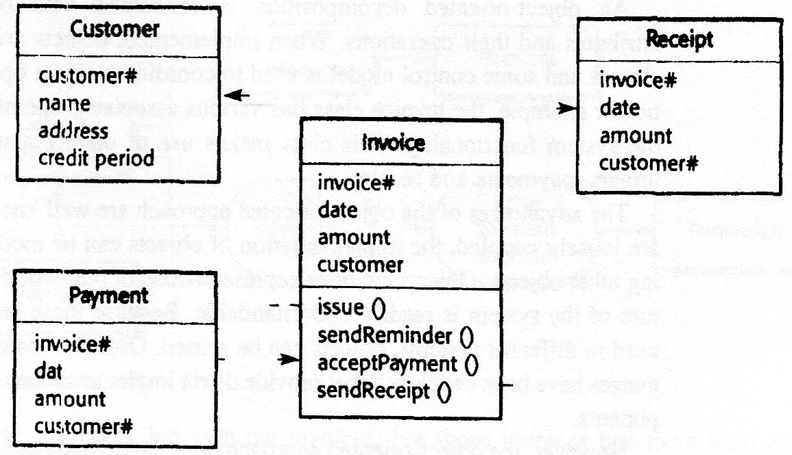
Example
Figure 5 An object model of an invoice processing system

Slide 37
Object-oriented decomposition
An object-oriented, architectural model structures the system into a set of loosely coupled, objects with well-defined interfaces. Objects call on the services offered by other objects.
Figure 5 is an example of an object-oriented architectural model of an invoice processing system.
This system can issue invoices to customers, receive payments, and issue receipts for these payments and reminders for unpaid invoices.

Slide 38
Object-oriented decomposition (cont … 1)
An object-oriented decomposition is concerned with object classes, their attributes and their operations. Objects are created from these classes and some control model is used to coordinate object operations.
The advantages of the object-oriented approach are well known, the implementation of objects can be modified without affecting other objects. Objects are often representations of real-world entities so the structure of the system is readily understandable and objects can be reused.
However, the object-oriented approach does have disadvantages. To use services, objects must explicitly reference the name and the interface of other objects.

Slide 39
Function-oriented pipelining
Functional transformations process their inputs and produce outputs.
Data flows from one to another and is transformed as it moves through the sequence.
Each processing step is implemented as a transform.
Input data flows through these transforms until converted to output.
The transformations may execute sequentially or in parallel.
The data can be processed by each transform item by item or in a single batch.

Slide 40
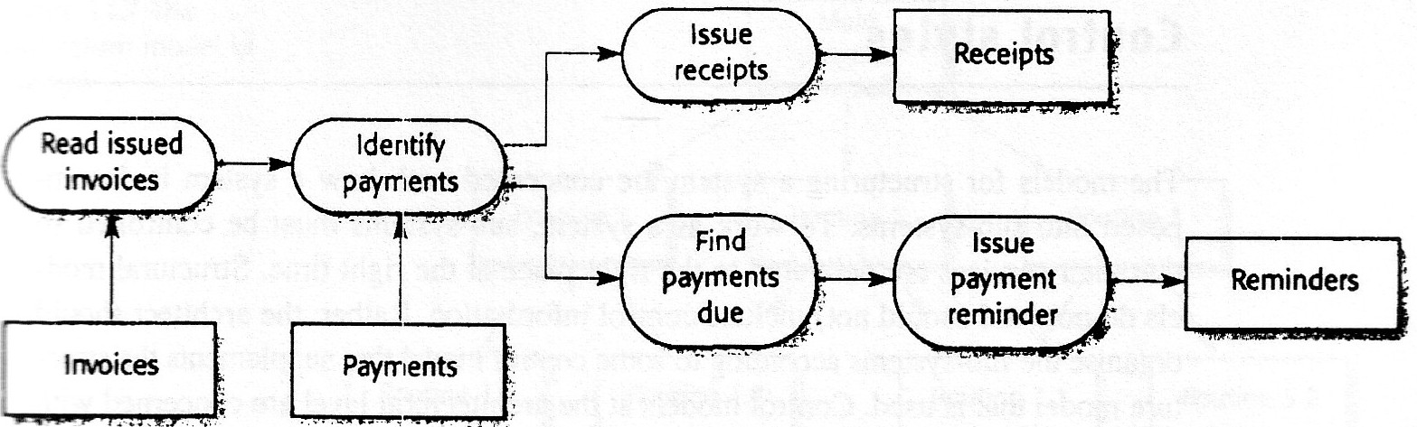
Example
Figure 11.6 A pipeline model of an invoice processing system

Slide 41
Example (cont … 1)
An organisation has issued invoices to customers. Once a week, payments that have been made are reconciled with the invoices.
For those invoices that have been paid, a receipt is issued.
For those invoices that have not been paid within the allowed payment time, a reminder is issued.
This is a model of only part of the invoice processing system; alternative transformations would be used for the issue of invoices.
Notice the difference between this and its object-oriented equivalent discussed in the previous section. The object model is more abstract as it does not include information about the sequence of operations.

Slide 42
Function-oriented pipelining (cont … 1)
The advantages of this architecture are:
It supports the reuse of transformations.
It is intuitive in that many people think of their work in terms of input and output processing.
Evolving the system by adding new transformations is usually straightforward.
It is simple to implement either as a concurrent or a sequential system.

Slide 43
Function-oriented pipelining (cont … 2)
The principal problem with this style is that there has to be a common format for data transfer that can be recognized by all transformations.
Each transformation must either agree with its communicating transformations on the format of the data that will be processed or with a standard format for all data communicated must be imposed.
The latter is the only feasible approach when transformations are standalone and reusable.

Slide 44
Function-oriented pipelining (cont … 2)
Interactive systems are difficult to write using the pipelining model because of the need for a stream of data to be processed.
While simple textual input and output can be modeled in this way, graphical user interfaces have more complex.
I/O formats and control, which is based on events such as mouse clicks or menu selections.
It is difficult to translate this into a form compatible with the pipelining model.

Slide 45
Control styles
The models for structuring a system are concerned with how a system is decomposed into sub-systems.
To work as a system, sub-systems must be controlled so that their services are delivered to the right place at the right time.
Structural models do not (and should not) include control information. Rather, the architect should organize the sub-systems according to some control model that supplements the structure model that is used.
Control models at the architectural level are concerned with the control flow between sub-systems.

Slide 46
Control styles (cont… 1)
There are two generic control styles that are used in software systems:
Centralised control, One sub-system has overall responsibility for control and starts and stops other sub-systems. It may also devolve control to another subsystem but will expect to have this control responsibility returned to it.
Event-based control, Rather than control information being embedded in a subsystem, each sub-system can respond to externally generated events. These events might come from other sub-systems or from the environment of the system.

Slide 47
Centralised control
In a centralized control model, one sub-system is designated as the system controller and has responsibility for managing the execution of other sub-systems.
Centralized control models fall into two classes, depending on whether the controlled sub-systems execute sequentially or in parallel.

Slide 48
Centralised control (cont … 1)
The call–return model, the familiar top-down subroutine model where control starts at the top of a subroutine hierarchy and, through subroutine calls, passes to lower levels in the tree. The subroutine model is only applicable to sequential systems.
The manager model, applicable to concurrent systems. One system component is designated as a system manager and controls the starting, stopping and coordination of other system processes. A process is a sub-system or module that can execute in parallel with other processes. A form of this model may also be applied in sequential systems where a management routine calls particular sub-systems depending on the values of some state variables. This is usually implemented as a case statement.

Slide 49
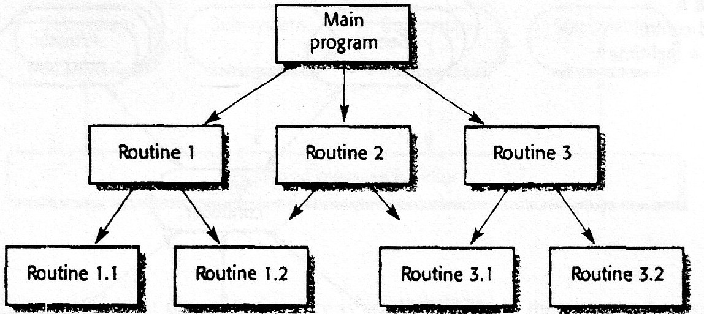
Example 1
Figure 7 The call–return model of control

Slide 50
Example 1 (cont … 1)
The main program can call Routines 1, 2 and 3;
Routine I can call Routines 1.2 or 1.2;
Routine 3 can call Routines 3.1 or 3.2; and so on.
This is a model of the program dynamics. It is not a structural model; there is no need for Routine 1,1, for example, to be part of Routine 1.
It then returns to the point where the routine was called. The currently executing subroutine has responsibility for control and can either call other routines or return control to its parent. It is poor programming style to return to some other point in the program.

Slide 51
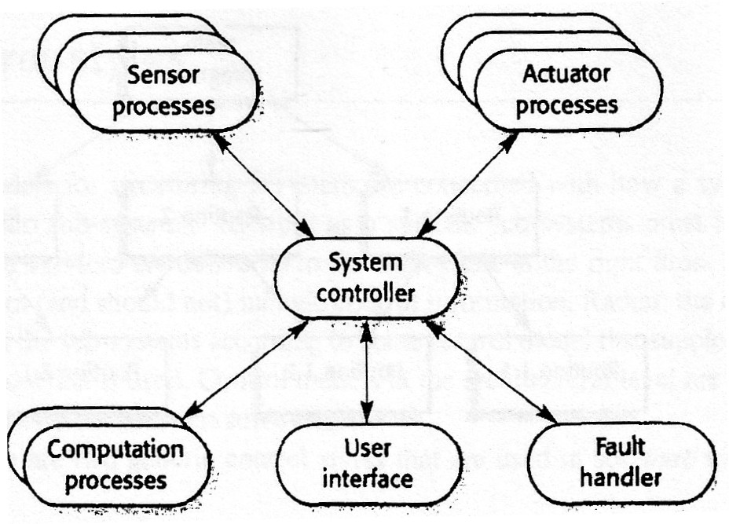
Example 2
Figure 8 centralised control model for a real-time system

Slide 52
Example 2 (cont … 1)
A centralized management model of control for a concurrent system. The central controller manages the execution of a set of processes associated with sensors and actuators.
The system controller process decides when processes should be started or stopped depending on system state variables. It checks whether other processes have produced information to be processed or to pass information to there for processing.
The controller usually loops continuously, polling sensors and other processes for events or state changes. For this reason, this model is sometimes called an event-loop model.

Slide 53
Event driven systems
In centralized control models, control decisions are usually determined by the values of some system state variables.
Event-driven control models are driven by externally generated events. The term event in this context does not just mean a binary signal. It may be a signal that can take a range of values or a command input from a menu. The distinction between an event and a simple input is that the timing of the event is outside the control of the process that handles that event.

Slide 54
Event driven systems (cont … 1)
There are many types of event-driven systems.
These include editors where user interface events signify editing commands, rule-based production systems as used in AI where a condition becoming true causes an action to be triggered, and active objects where changing a value of an object's attribute triggers some actions.

Slide 55
Event driven systems (cont … 1)
There are two event-driven control models:
Broadcast models, an event is broadcast to all sub-systems. Any sub-system that has been programmed to handle that event can respond to it.
Interrupt-driven models, exclusively used in real-time systems where external interrupts are detected by an interrupt handler. They are then passed to some other component for processing.

Slide 56
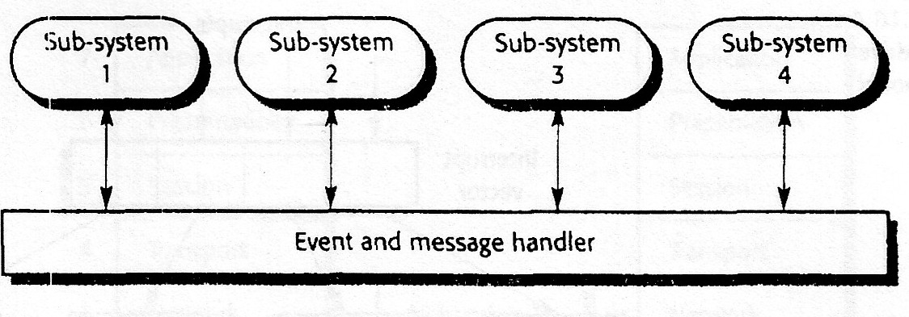
Example
Figure 9 A control model based on selective broadcasting

Slide 57
Event driven systems (cont … 1)
Broadcast models are effective in integrating sub-systems distributed across different computers on a network. Interrupt-driven models are used in real-time systems with stringent timing requirements.
Sub-systems register an interest in specific events. When these events occur, control is transferred to the sub-system that can handle the event.
The distinction between this model and the centralized model show in Figure 8 is that the control policy is not embedded in the event and message handler. Sub-systems decide which events they require, and the event and message handler ensures that these events are sent to them.

Slide 58
Event driven systems (cont … 2)
The advantage is relatively simple. A new scab-system to handle particular classes of events can be integrated by registering its events with the event handler. Any sub-system can activate any other sub-system without knowing its name or location. The sub-systems can be implemented on distributed machines.
The disadvantage is that sub-systems don't know if or when events will be handled. When a sub-system generates an event it does not know which other sub-systems have registered an interest in that event. It is quite possible for different sub-systems to register for the same events. This may cause conflicts when the results of handling the event are made available.

Slide 59
Event driven systems (cont … 2)
Real-time systems that require externally generated events to be handled very quickly must be event-driven. For example, if a real-time system is used to control the safety systems in a car, it must detect a possible crash and, perhaps, inflate an airbag before the driver's head hits the steering wheel.
To provide this rapid response to events, we have to use interrupt-driven control.

Slide 60
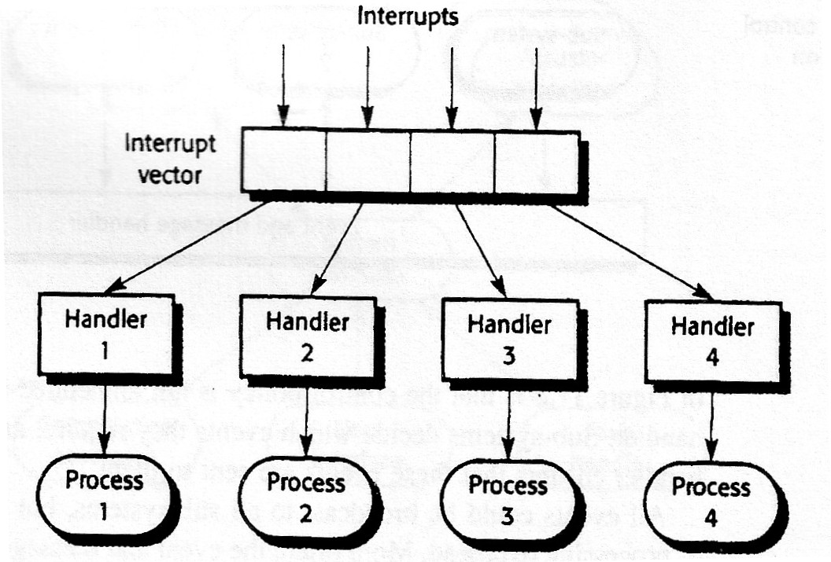
Event driven systems (cont … 3)
Figure 10 An interrupt-driven control model

Slide 61
Event driven systems (cont … 4)
There are a known number of interrupt types with a handler defined for each type. Each type of interrupt is associated with the memory location where its handler's address is stored. When an interrupt of a particular type is received, a hardware switch causes control to be transferred immediately to its handler. This interrupt handler may then start or stop other processes in response to the event signaled by the interrupt.
This model is mostly used in real-time systems where an immediate response to some event is necessary. It may be combined with the centralized management model. The central manager handles the normal running of the system with interrupt-based control for emergencies.

Slide 62
Event driven systems (cont … 4)
The advantage is that it allows very fast responses to events to be implemented.
The disadvantages are that it is complex to program and difficult to validate. It may be impossible to replicate patterns of interrupt timing during system testing. It can be difficult to change systems developed using this model if the number of interrupts is limited by the hardware. Once this limit is reached, no other types of events can be handled.
We can sometimes get around this limitation by mapping several types of events onto a single interrupt.

Slide 63
Assignments:
Design an architecture for the above systems based on your choice of model. Make reasonable assumptions about the system requirements.
Real-time systems usually use event-driven models of control. Under what circumstances would you recommend the use of a call–return control model for a real-time system?
Giving reasons for your answer, suggest an appropriate control model for the following systems:

Slide 64
Assignments: (cont … )
A batch processing system that takes information about hours worked and pay rates and prints salary slips and bank credit transfer information.
A set of software tools that are produced by different vendors, but which must work together.
A television controller that responds to signals from a remote control unit.
Discuss their advantages and disadvantages as far as distributability is concerned of the data-flow model and the object model. Assume that both single machine and distributed versions of an application are required.
GOOD LUCK !!

Slide 65
THANK YOU

